Slide 1




PDS
Computer Vision
Introduction to Cloud Computing
https://github.com/siagianp
https://www.youtube.com/@AmelOline/videos
https://github.com/amelcharolinesgn2/Cloud-Infrastructures
https://github.com/amelcharolinesgn2/ClouD-Infrastructure-SISKA-2025
https://github.com/amelcharolinesgn2/CCNA1
https://github.com/amelcharolinesgn2/CCNA2
https://github.com/amelcharolinesgn2/AWS Certificate
Notes:
Lab Session 01: AWS Compute Foundations – EC2, Networking, and Application Deployment Lab Session 02: Identity and Access Control with IAM Lab Session 03: Cloud Storage Solutions – S3, EBS, and EFS Lab Session 04: Database Services – RDS, DynamoDB, and ElastiCache Lab Session 05: Load Balancing and Auto Scaling Lab Session 06: Container Orchestration with ECS, Fargate, and EKS Lab Session 07: Serverless Computing with Lambda Lab Session 08: Monitoring, Logging, and Security Auditing Lab Session 09: Infrastructure as Code – CloudFormation, CDK, and Terraform Lab Session 10: CI/CD Pipelines – App Runner, CodePipeline, GitHub Actions, and CodeDeploy Lab Session 11: AI/ML Services – Rekognition, Comprehend, Translate, and SageMaker Lab Session 12: Hybrid Cloud Networking – VPC Peering, Transit Gateway, VPN, and Direct Connect Lab Session 13: Security and Compliance – AWS Config, GuardDuty, Security Hub, and KMS Lab Session 14: Disaster Recovery and Business Continuity – AWS Backup, Multi-Region, and Failover Lab Session 15: Migration and Modernization – DataSync, DMS, MGN, Containers, and Serverless
Lab Session 16: Cost Management and Optimization – Cost Explorer, Trusted Advisor, Budgets, and Well-Architected
https://www.youtube.com/watch?v=SOTamWNgDKc&t=19604s

Slide 2
Introduction to Cloud Computing
Understanding the Foundations of Modern IT Infrastructure

Slide 3

Introduction to Cloud Computing
Cloud computing is the delivery of on-demand computing services—such as servers, storage, databases, networking and more—over the internet ('the cloud').
Compare cloud computing to utility services like electricity or water on-demand, scalable, and pay-as-you-go

Slide 4
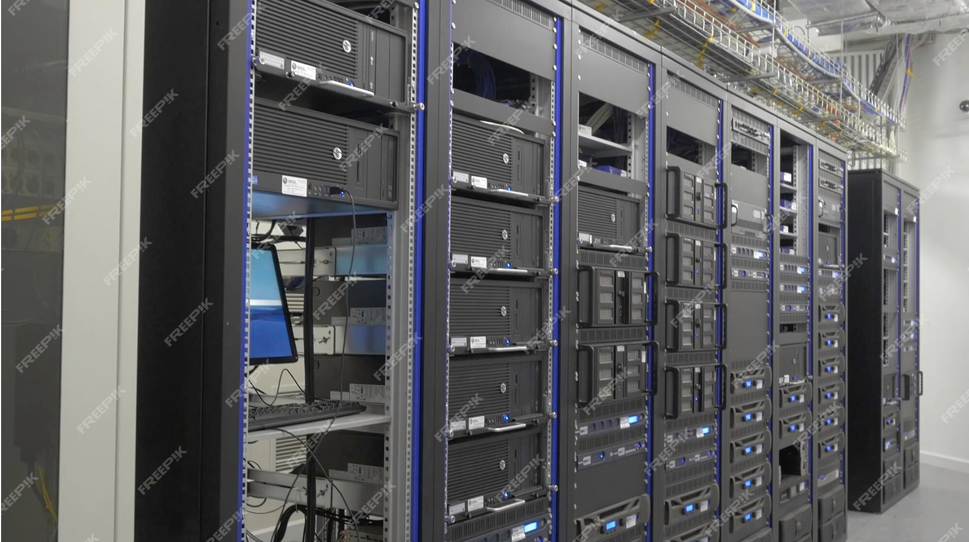
Server in Server Rack

Slide 5
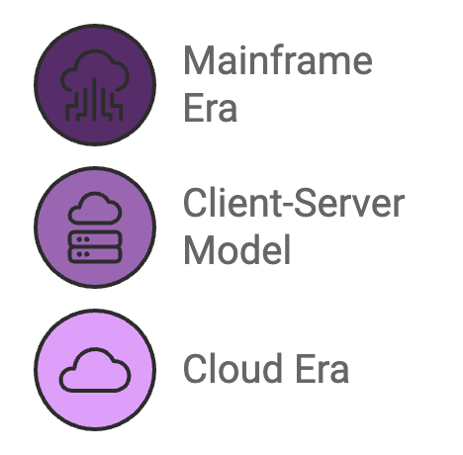
2. Evolution of Computing
Mainframe Era (1950s-1970s): Centralized computing, limited to large organizations.
Client-Server Model (1980s-1990s): Decentralized computing with personal computers and local servers.
Cloud Era (2000s-Present): On-demand, scalable resources available globally, thanks to advances in virtualization, internet speed, and storage.

Slide 6
3. Key Characteristics of Cloud Computing
On-Demand Self-Service: Users can provision resources automatically.
Broad Network Access: Available over the network, accessible from various devices.
Resource Pooling: Multi-tenant model with dynamic allocation.
Rapid Elasticity: Scale up/down based on demand.
Measured Service: Pay only for what you use.

Slide 7
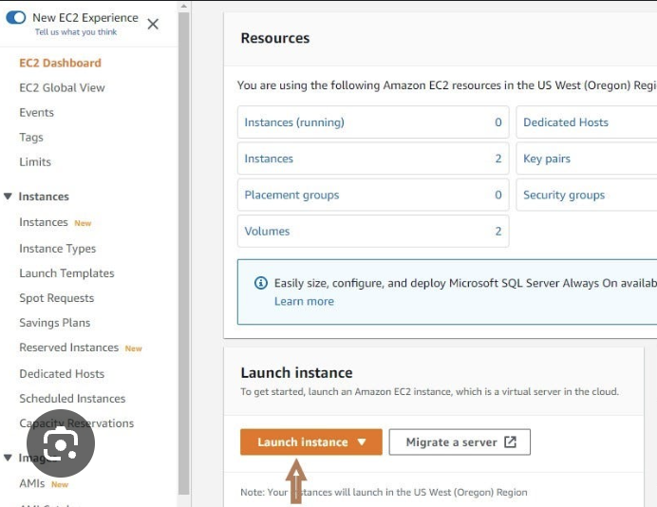
On-Demand Self-Service:
Users can access computing resources like servers and storage automatically, without human interaction with service providers.
Example: Launching a virtual machine (VM) on AWS.

Slide 8
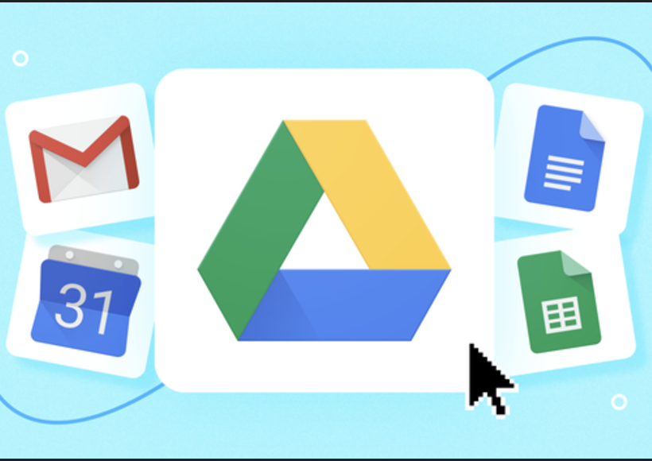
Broad Network Access
Services are accessible over the network via standard devices such as laptops, smartphones, or tablets.
Example: Accessing Google Drive from any device.

Slide 9
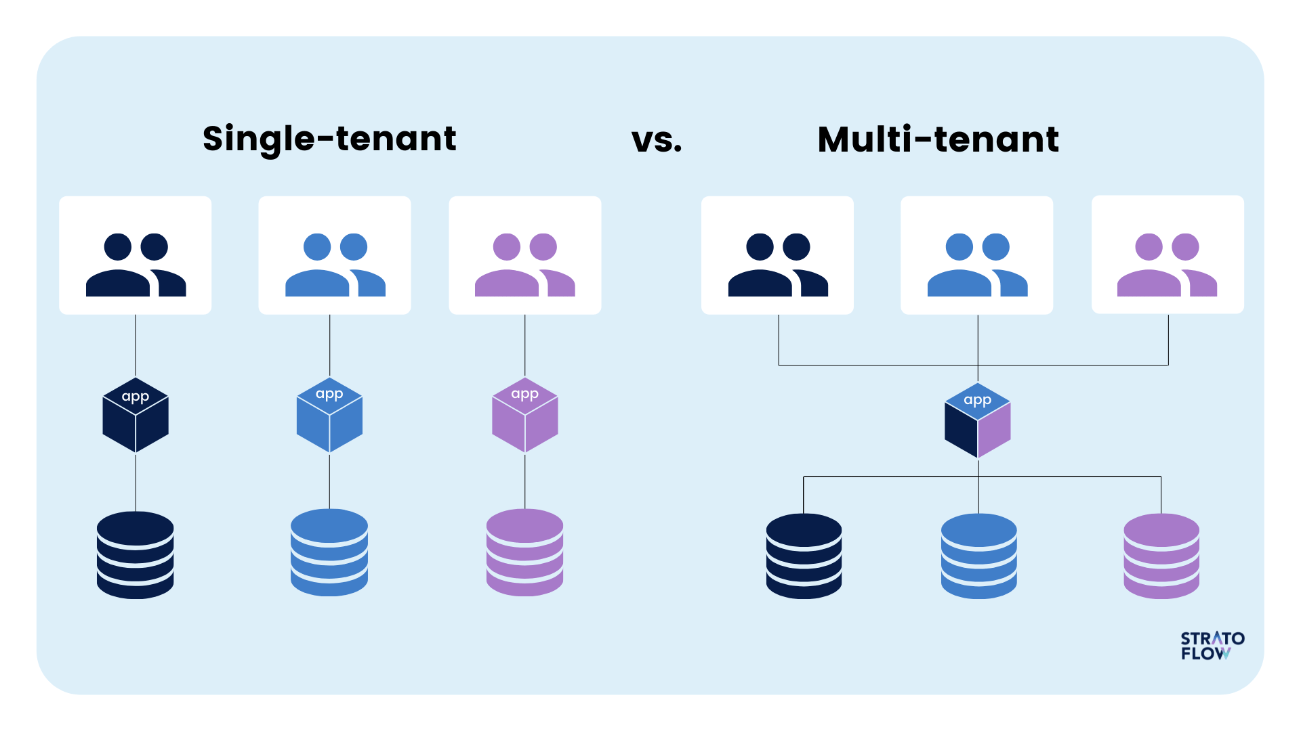
Resource Pooling:
Providers pool resources to serve multiple users using a multi-tenant model. Resources are dynamically assigned.
Example: AWS uses data centers globally to serve customers seamlessly.

Slide 10
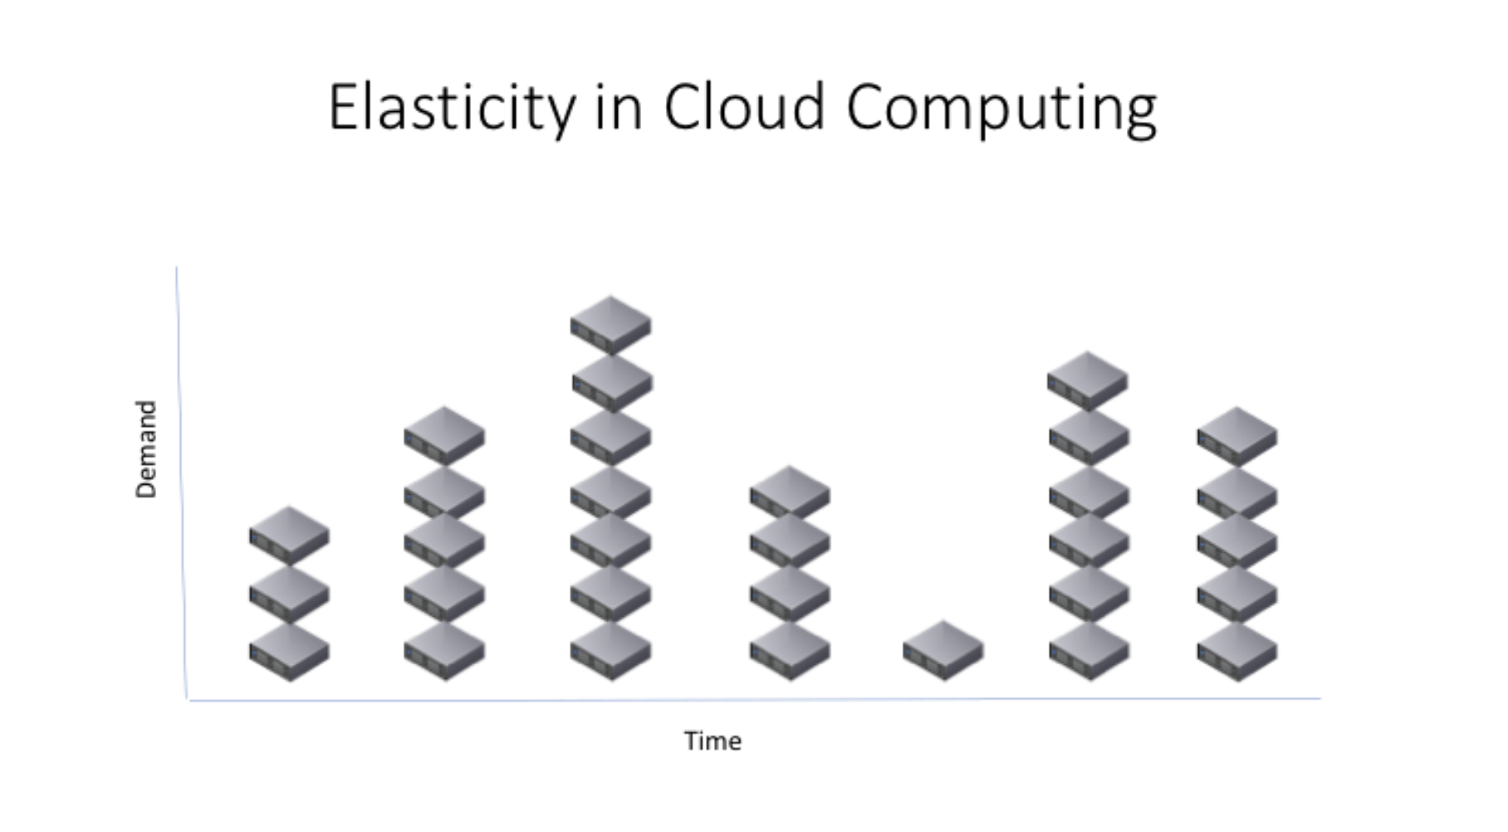
Rapid Elasticity:
Resources can be scaled up or down automatically or manually.
Example: E-commerce platforms scaling up during Eid sales.

Slide 11
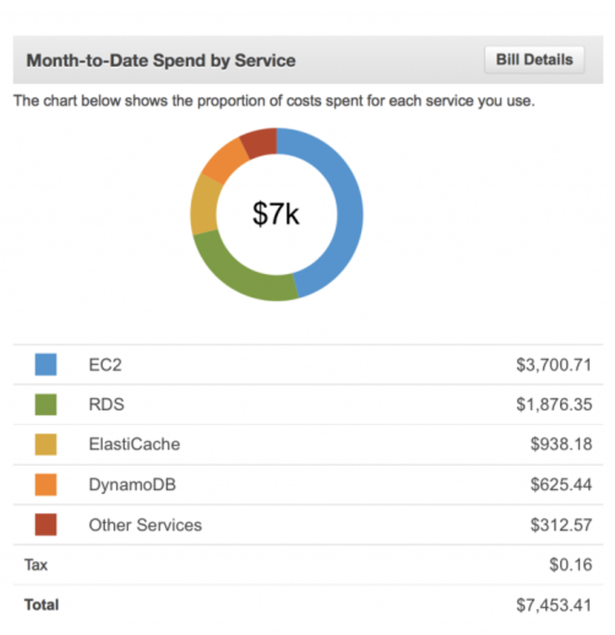
Measured Service:
Cloud systems automatically control and optimize resource usage, providing a metering capability.
Example: AWS bills based on the number of compute hours or storage used.

Slide 12
4. Cloud Service Models
IaaS (Infrastructure as a Service):
Example: AWS EC2, Google Compute Engine
Provides virtualized computing resources (VMs, storage, etc.)
PaaS (Platform as a Service):
Example: AWS Elastic Beanstalk, Google App Engine
Provides a platform for developing, testing, and deploying applications.
SaaS (Software as a Service):
Example: Gmail, Dropbox, Salesforce
Users access software over the internet without managing infrastructure.

Slide 13
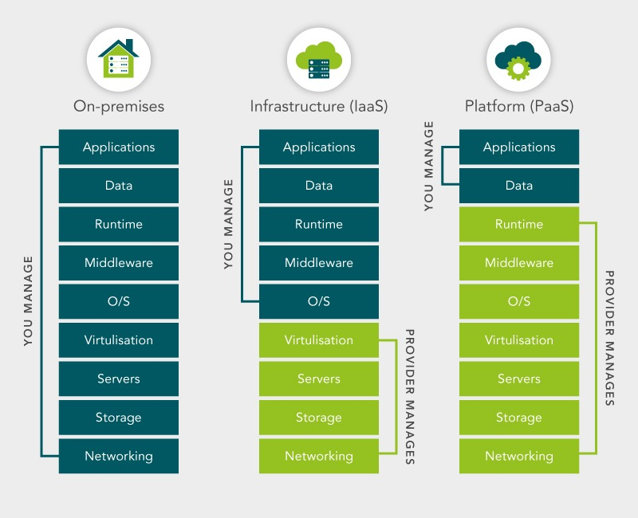
Responsibility Sharing

Slide 14
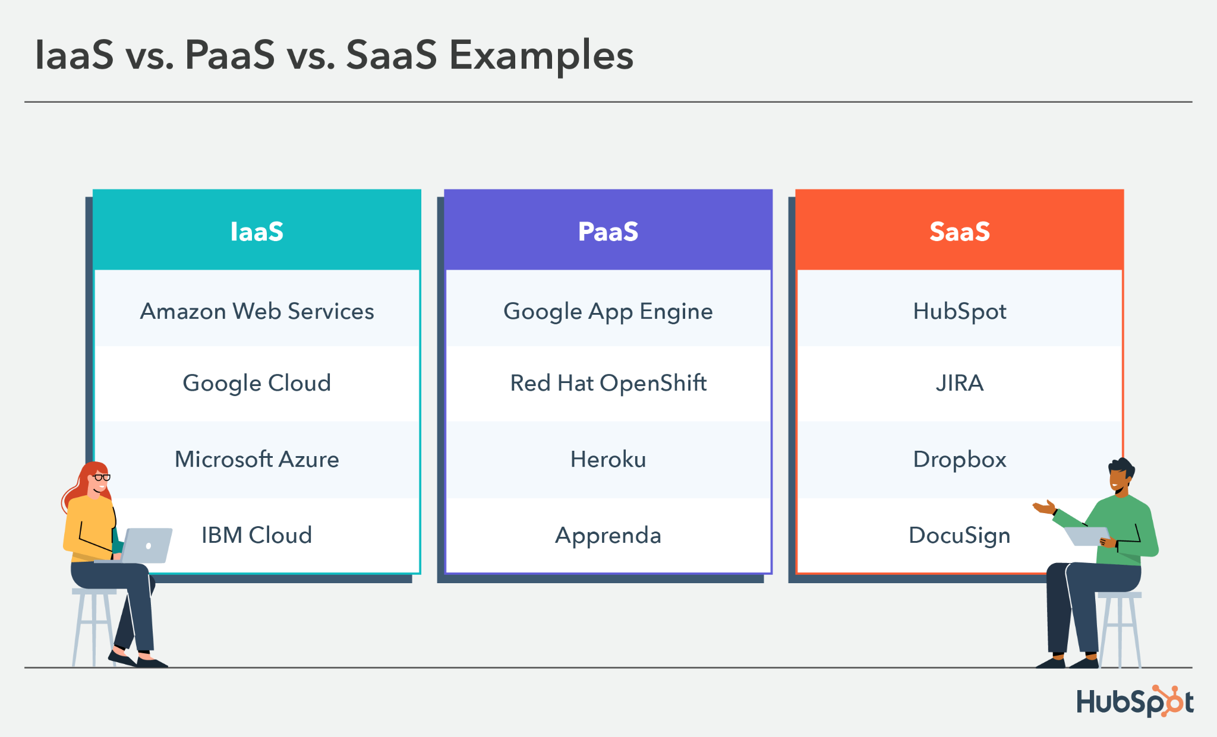

Slide 15
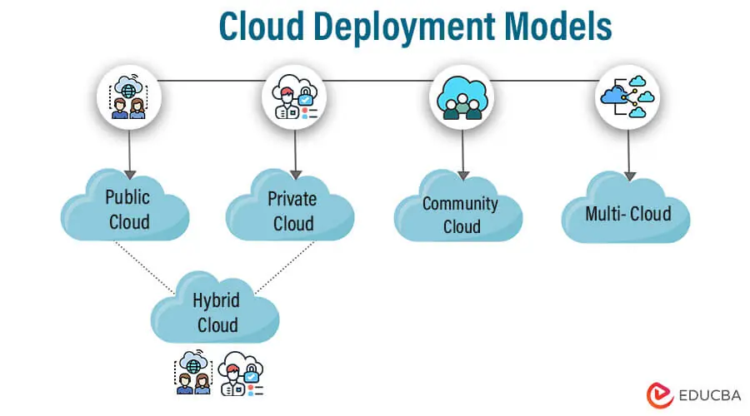
5. Cloud Deployment Models
Public Cloud: Services offered over the internet (e.g., AWS, Azure, GCP).
Private Cloud: Cloud infrastructure dedicated to a single organization.
Hybrid Cloud: Combination of public and private clouds.
Community Cloud: Shared by organizations with a common goal.

Slide 16
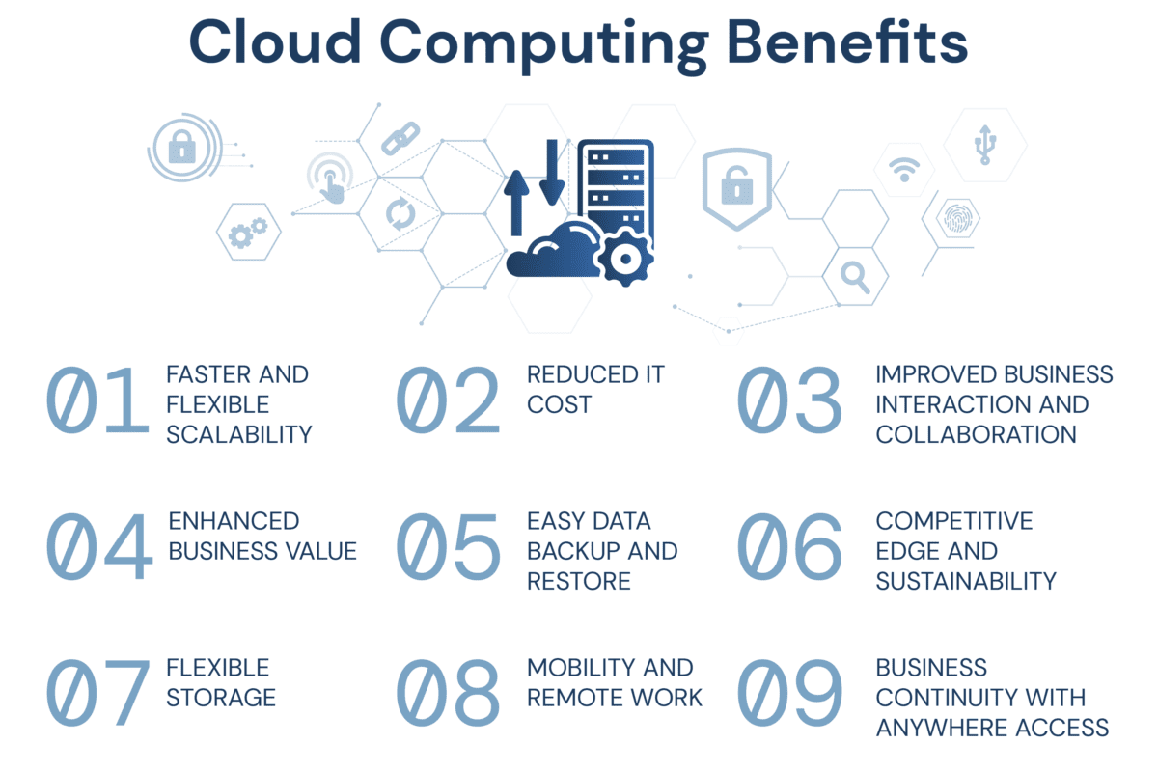
6. Benefits of Cloud Computing
1. Cost efficiency
2. Scalability and elasticity
3. High availability and redundancy
4. Innovation acceleration

Slide 17
7. Challenges in Cloud Computing
Data security and privacy (Cloud did not used in govt project)
Vendor lock-in
Downtime risks

Slide 18
Summary
Cloud computing delivers on-demand IT services over the internet.
Three service models: IaaS, PaaS, SaaS.
Four deployment models: Public, Private, Hybrid, Community.
Benefits include cost efficiency, scalability, and innovation, but challenges like security and vendor lock-in remain.

Slide 19
THANK YOU
Amel Online & Irene magdalena
https://github.com/siagianp
https://www.youtube.com/@AmelOline/videos
https://github.com/amelcharolinesgn2/Cloud-Infrastructures
https://github.com/amelcharolinesgn2/ClouD-Infrastructure-SISKA-2025
https://github.com/amelcharolinesgn2/CCNA1
https://github.com/amelcharolinesgn2/CCNA2
https://github.com/amelcharolinesgn2/AWS Certificate

Slide 20
Thank You
Open for Questions
https://github.com/siagianp
https://www.youtube.com/@AmelOline/videos
https://github.com/amelcharolinesgn2/Cloud-Infrastructures
https://github.com/amelcharolinesgn2/ClouD-Infrastructure-SISKA-2025
https://github.com/amelcharolinesgn2/CCNA1
https://github.com/amelcharolinesgn2/CCNA2
https://github.com/amelcharolinesgn2/AWS Certificate

